Slide 1
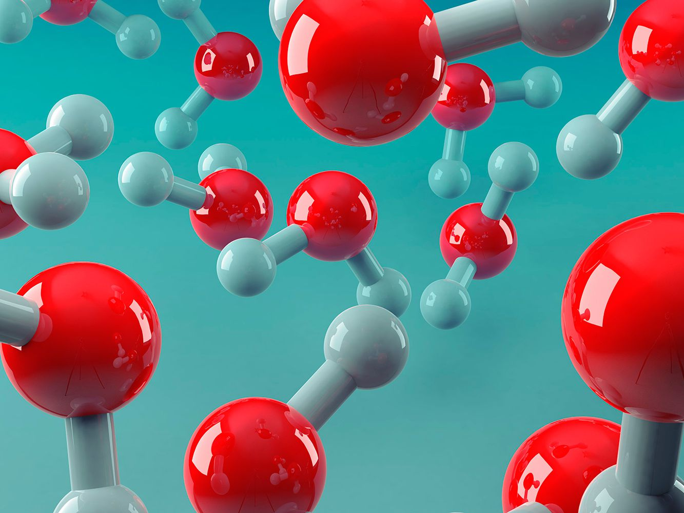
Covalent bonding

Slide 2
Covalent bonding
Essential Idea: Covalent compounds form by the sharing of electrons.
Nature of Science:
Looking for trends and discrepancies – compounds that contain non-metals have different properties from compounds that contain metals.
Use theories to explain natural phenomena – Lewis introduced a class of compounds which share electrons. Pauling used the idea of electronegativity to explain unequal sharing of electrons.

Slide 3
Covalent bonding
Understandings:
A covalent bond is formed by the electrostatic attraction between a shared pair of electrons and the positively charged nuclei.
Single, double, and triple covalent bonds involve one, two, and three shared pairs of electrons, respectively.
Bond length decreases and bond strength increases as the number of shared electrons increases.
Bond polarity results from the difference in electronegativities of the bonded atoms.

Slide 4
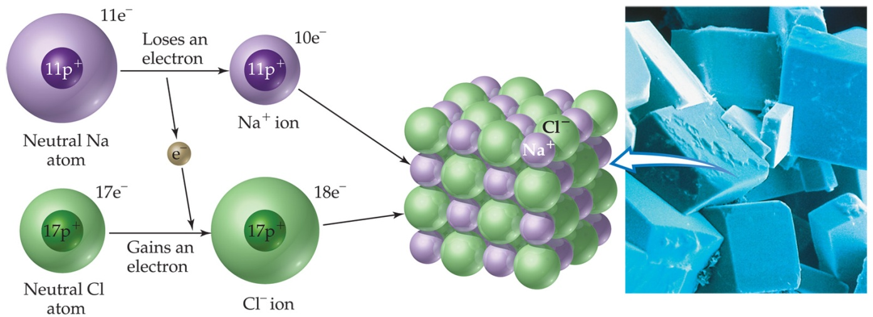
Recall
Remember – there is not one molecule of NaCl as there is not a single ionic bond, per se, the attractive forces between the ions are the same in all directions. So, like metallic bonding, ionic bonding is said to be non-directional

Slide 5
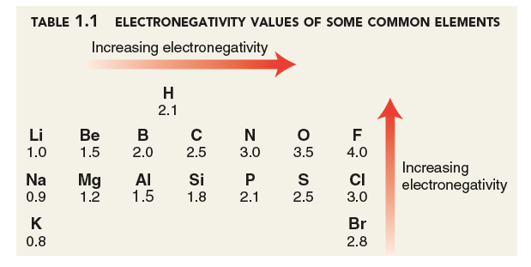
Recall
For an electron transfer to occur one atom needs to have a greater electronegativity (a high electrostatic attraction for its valence electron and the valence electrons of atoms in close proximity) than the other atom
The difference in electronegativity needs to be greater than 1.8
Predictions:
Li and O
Mg and Cl
C and O
Br and Br
3.5 – 1.0 = 2.5 > 1.8 ionic
3.0 – 1.2 = 1.8 = 1.8 ionic
3.5 – 2.5 = 1.0 < 1.8 covalent
2.8 – 2.8 = 0 < 1.8 covalent

Slide 6
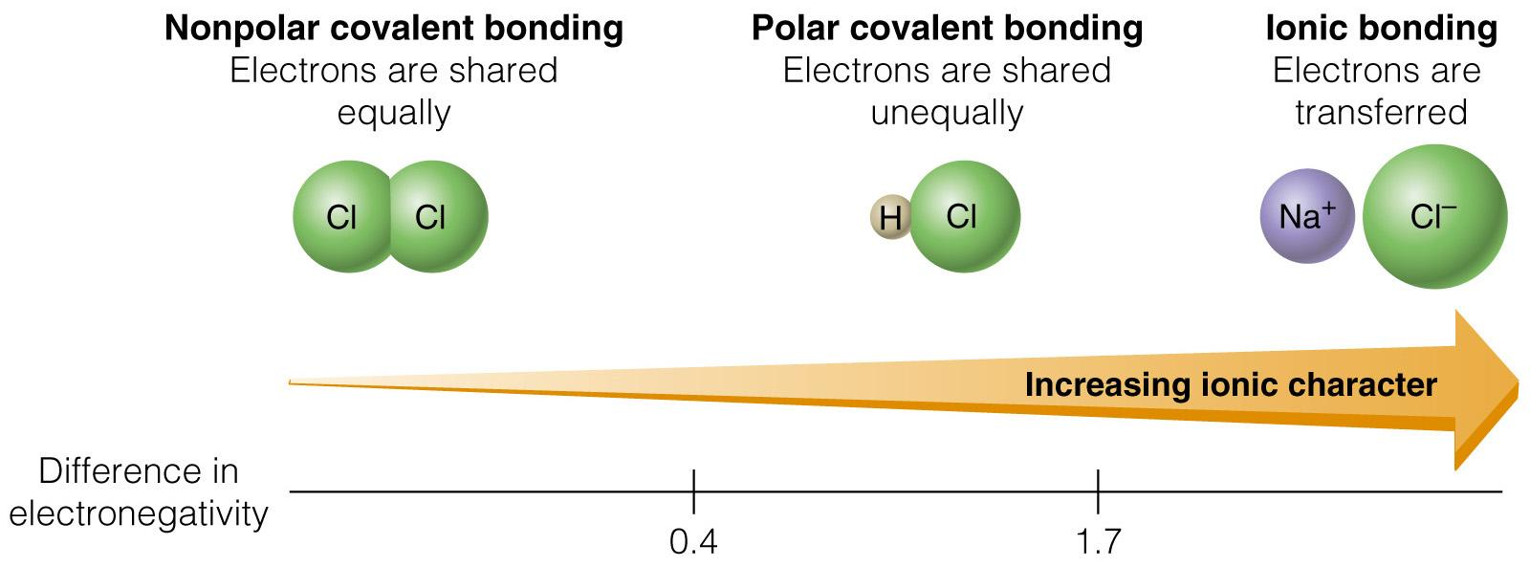
EN to predict bonding

Slide 7
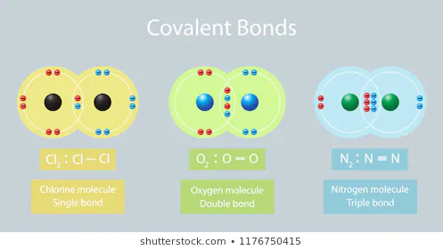
Covalent bonding
Covalent bonds occur between nonmetals since both want to gain electrons. They share electrons to achieve a noble gas (stable) configuration (8 valence e-).
The electrons in the bond are electrostatically attracted by both nuclei, so that it forms a directional bond between the two atoms (recall: metallic bonding and ionic bonding are nondirectional)

Slide 8
Covalent bonding
Covalent bonds occur between nonmetals since both want to gain electrons. They share electrons to achieve a stable configuration
Lewis Dot Diagrams are used to illustrate the sharing of electrons
Need 1 electron: H F Cl Br I
Need 2 electrons: O S Se Te
Need 3 electrons: N P As
Need 4 electrons: C Si
(spread out e- if 4)

Slide 9

Covalent bonding
Why should two atoms share electrons?
F
+
F
F
F
7e⁻
7e⁻
8e⁻
8e⁻
Lewis structure of F₂
single covalent bond
F
F
F
F
single covalent bond

Slide 10
Covalent bonding
Key Terms:
Lone pairs: electrons on a dot diagram that are already paired (also called non-bonding pairs)
Shared pairs (Bonded pair): electrons that are shared in a covalent bond
Shared pair or bonding pair
F
F
F
F
Lone pair or non-bonding pairs

Slide 11
Covalent bonding
Single bond – two atoms share one pair of electrons (single bond 2 e⁻)
8e⁻
2e⁻
single covalent bonds
2e⁻
H
+
O
+
H
H
O
H
or
H
O
H
Double bond – two atoms share two pairs of electrons (double bond 4 e⁻)
O
C
O
or
O
C
O
double bonds
double bonds
Triple bond – two atoms share three pairs of electrons (triple bond 6 e⁻)
N
N
or
N
N
triple bond
triple bond

Slide 12
Covalent bonding
The more pairs of electrons that are shared between two atoms in a bond then the stronger the bond and the shorter the bond length.
Bond lengths:
 | Length nm | Strength (kj mol-1)
C-O | 0.143 | 356
C-C | 0.154 | 348
C=O | 0.121 | 736
C=C | 0.134 | 657
C C | 0.120 | 908
Triple bond < Double bond < Single bond
shortest
longest

Slide 13
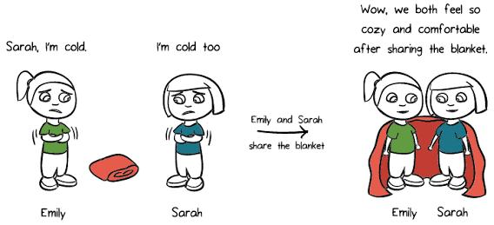
Covalent bonding
Two types of Covalent substances:
Covalent molecular substances (e.g. water, oxygen, sucrose)
Covalent network substances (e.g. graphite, silicon dioxide – sand)

Slide 14
Covalent molecular substances
Essential learning:
Most compounds containing only non-metals are molecules
Molecules are small clusters of covalently bonded atoms
Intramolecular forces vs Intermolecular forces
Examples and properties of covalent molecular substances

Slide 15
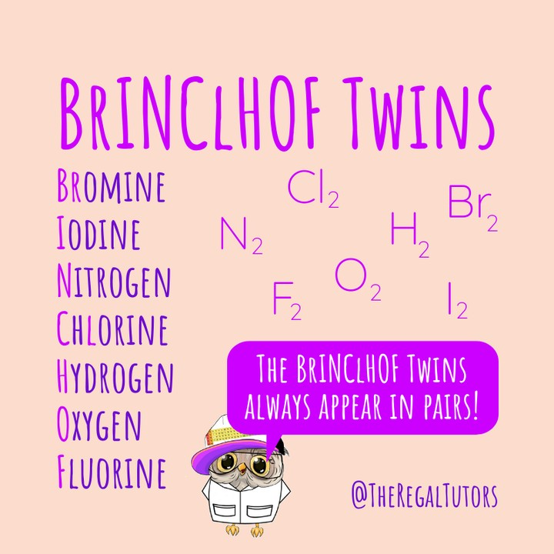
Covalent molecular substances
Molecules contains only two atoms are call diatomic molecules (e.g. H₂, HCl)
Includes the seven elements that form pure diatomic molecules:
Molecules that contain more than two atoms are called polyatomic molecules
E.g. Water, H₂O, the oxygen needs more valence electrons to complete its outer shell than one hydrogen can provide so it bonds with two hydrogen atoms
Polyatomic ions are small charged molecules, such as hydroxide OH⁻ or ammonium NH₄⁺ they contain covalent bonds within the molecule but form ionic bonds between ions.

Slide 16
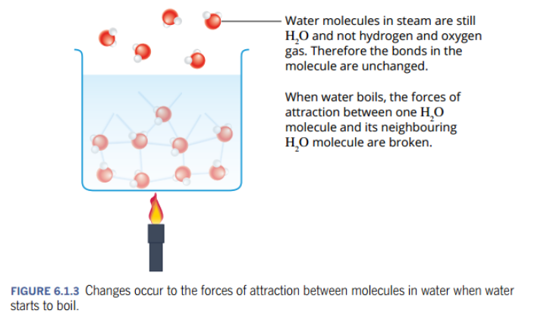
Covalent molecular substances
Consider the properties of water
Forces between atoms are strong, it is hard to break the H-O bonds.
Forces between water molecules – weak and easy to break. So water has a low boiling point.
Ref: Pearson, Yr 11 ATAR Chemistry, WA edition

Slide 17
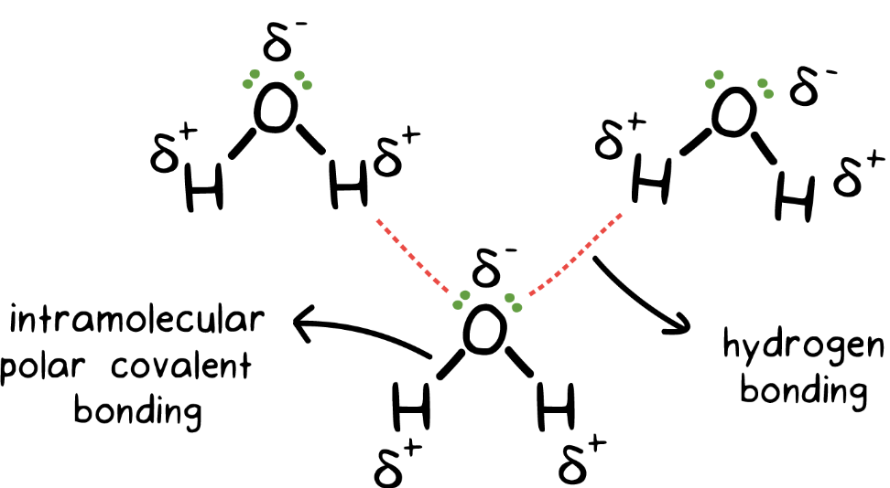
Covalent molecular substances
>
Intramolecular forces
Inside molecule
Intermolecular forces
between molecules
(greater than)
Ref: https://www.khanacademy.org/test-prep/mcat/chemical-processes/covalent-bonds/a/intramolecular-and-intermolecular-forces

Slide 18
Covalent molecular substances
Covalently bonded clusters of atoms are called molecules
Molecules include most compounds containing only non-metals, for example: water, ammonia, methane, sulfuric acid
Molecules contain strong internal intramolecular forces – covalent bonds and weak intermolecular forces – e.g. van der Waals forces.
Let us apply our knowledge to these two forces and covalent bonding in general to the general properties of covalent molecular substances.

Slide 19
Covalent molecular substances
Low to moderate boiling points:
For a substance to boil the interactions between molecules needs to be overcome
What force of attraction exists between molecules?
Is this a strong or weak attraction?
Weak attraction = low energy required to disrupt, which results in a low boiling point.
Does boiling break covalent bonds?
Intermolecular forces
A weak attraction
No, it does not break any covalent bonds. It only disrupts the weak attraction between molecules not the strong attraction (bonds) within a molecule.

Slide 20
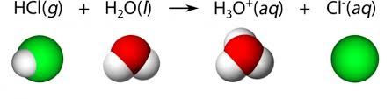
Covalent molecular substances
Non-conductor of electricity (solid, molten and aqueous solutions)
Recall – for a substances to conduct electricity there needs to be movement of charged particles
Covalent molecular substances the electrons are localized between the nuclei, so they are not free to move
No cations and anions in a covalent molecular substance
**Trick point: some molecules reacts with water to produce ions. For example HCl, NH₃ and H₂SO₄. The ionisation reaction produces ions in aqueous solutions and they do conduct electricity but they are now ionic

Slide 21
Covalent molecular substances
Soft and weak
Strong bonds only exist within each molecule (intramolecular attraction is strong)
Between molecules (intermolecular attraction) is weak, so it is easy for the molecules to move apart.
Covalent molecular substances can be gases (e.g Cl₂, H₂, HCl), liquids (e.g. H₂O, H₂SO₄) or solids (e.g. sucrose). Notice the melting/freezing point is roughly linked to molecular mass
Some of solids, such as waxes, are malleable

Slide 22
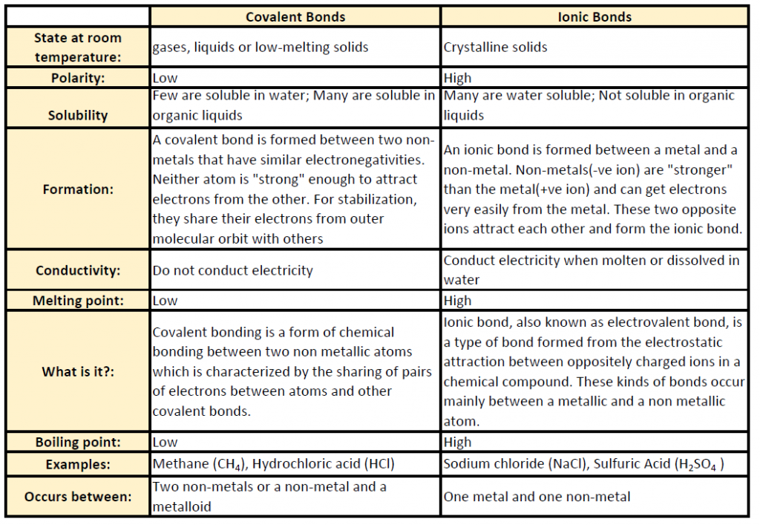
Covalent molecular substances

